Slide 1


Slide 2

*I am originally from upstate NY & took time off to stay at home with my 2 amazing children before returning to teaching.
*I have taught 1st grade and 3rd grade prior to coming to Carpenter.
*This is my 5th year teaching 5th grade at Carpenter.
*I am passionate about what I do and try to have fun in the classroom while also enforcing strong character morals with my students.
*I will love them and treat them like my own while we are here!

Slide 3

I WILL:
*Establish & maintain a caring community
environment
*Adhere to and teach the curriculum
standards
*Offer multiple methods of instruction
* Communicate with you frequently regarding
both class and individual student needs

Slide 4

Students are expected to:
*Come to school prepared & ready to learn
*Follow school & classroom code of conduct to maximize time spent learning
*Display respect, integrity & accountability by completing assignments and homework & turning them in on time
*Treat their classmates with respect & kindness

Slide 5

Our 5th grade leaders are expected to follow the school-wide BE LIKE CARY code of conduct at all times.
Our leaders are the role models for the entire school and should see themselves and conduct themselves as such.
Our leaders should abide by the Wake County Student Handbook that was sent home on the first day of school.

Slide 6
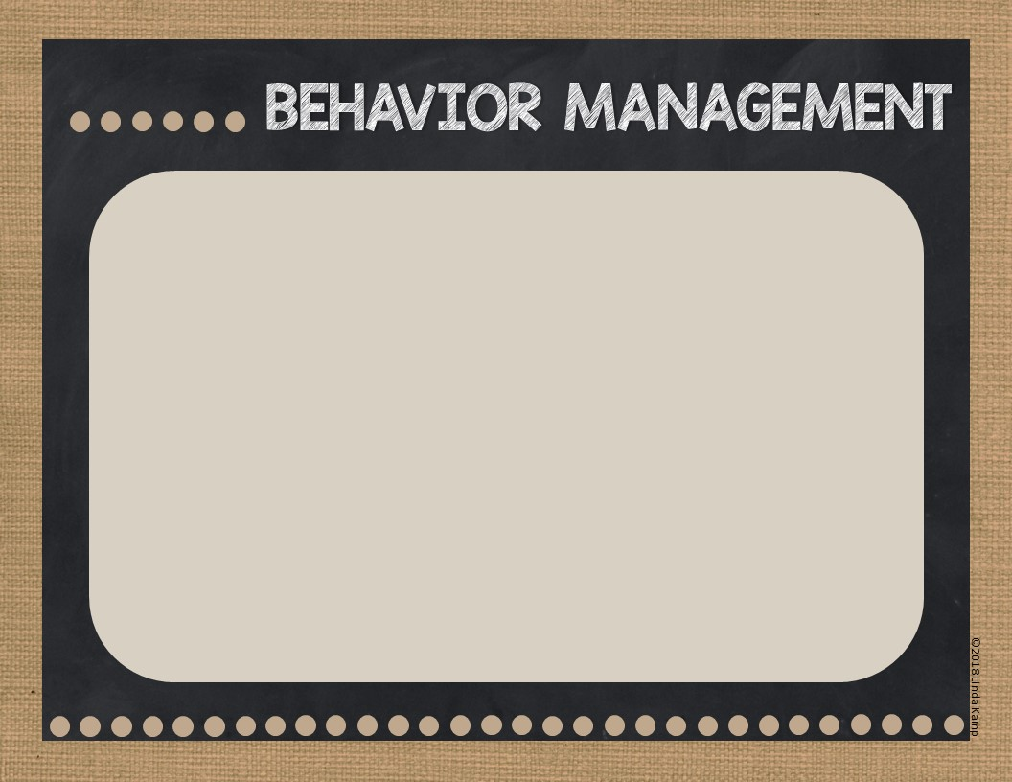
I have VERY HIGH EXPECTATIONS with regards to student behavior in my classroom.
Students are expected to demonstrate integrity and respect whether working independently, with a partner or in a small group setting.
Students that make the choice to behave in a manner that does not meet expectations will be provided 2 redirections and then a reflection referral will be sent home.
Should a behavior continue, parents will be notified, a conference scheduled & the student will be placed on a behavior plan.

Slide 7

I will communicate with you via:
*The class REMIND app (please be sure to sign up if you haven’t already)
*Email ~ Monthly/As Needed
*Bi-weekly newsletters which are simply uploaded onto my classroom website (Mrs.Gordons5thGradeGarden@Weebly.Com)
*Phone Calls –typically only in emergency situations

Slide 8

Please bookmark our class website – Mrs.Gordon’s5thGradeGarden@Weebly.Com –
and visit often with your student
*Daily & Specials Schedule
*Bi-Weekly/Monthly Newsletters
*Student Links to Websites
*Curriculum related videos to help students with concepts
*State Standards & Curriculum Information

Slide 9

We have A LOT to cover this year in preparation for Middle School!
*More than just academics!
*Organization Skills
*Life Skills/People Skills

Slide 10

BRAND NEW ELA CURRICULUM
Quarter 1:
Stories of Human Rights – reading Esperanza Rising
Quarter 2:
Research to Build Knowledge & Teach Others – Biodiversity in the Rainforest
Quarter 3:
Athlete Leaders of Social Change –
Quarter 4:
The Impact of Natural Disasters -

Slide 11

This year students will write Personal Narratives, Poetry, Opinion/Persuasive pieces as well as Research Based pieces.
Students will respond to writing prompts within the new ELA curriculum as well as in Math, Science and Social Studies.

Slide 12

5th Grade Focus:
First Quarter
*Numerical Patterns
*Coordinate Points & Grid Systems
*Multiplication & Division
This year we will also cover:
*Fractions (addition, subtraction, multiplication &
division of)
*Place Value & Metric Measurement
*Decimals (addition, subtraction, multiplication &
division of)
*Geometry, Order of Operations*

Slide 13

First Quarter:
Traits & Human Body Systems
Second Quarter:
Ecosystems
Third Quarter:
Force & Motion
Fourth Quarter:
Weather
EOG is on all 4 quarters of material

Slide 14

SOCIAL STUDIES
Quarter 1: American Revolution
Quarter 2: Westward Expansion
Quarter 3: Civil War
Quarter 4: Economy

Slide 15

WE ARE LUCKY THAT OUR SPECIALS SCHEDULE DOES NOT CHANGE FROM QUARTER TO QUARTER THIS YEAR!
MONDAY: ART
TUESDAY: TECHNOLOGY
WEDNESDAY: MEDIA
THURSDAY: PE (STUDENTS NEED TO WEAR SNEAKERS IN ORDER TO PARTICIPATE)
FRIDAY: MUSIC

Slide 16

We will use both a 4 point scale and a 10 point scale in order to help familiarize students with the middle school grading format.
First Quarter: 100-85% = 4
84-70% = 3
69-50% = 2
49% & Below = 1
The point spread will narrow each quarter in order to prepare students for middle school.
***Late work will lose 1 point per day late – unless a student has been absent.
***When possible students will be provided a RUBRIC at the beginning of a project so they can work towards a level 4 at all
times.

Slide 17

Students are expected to:
*Read for 30 minutes each night
*Complete each night’s review tasks for Literacy & Math
*Practice their Multiplication Facts
*Homework is assigned Monday – Thursday
*Homework is to be written in student AGENDA and parents are to sign agenda each night
*Homework is to be turned in the following day unless otherwise stated
*Late or missing 2x’s: Parent Email; 3x’s Reflection Referral
*Counts as part of student Work Habits & Conduct grade on report card (next year will count as part of overall grade)
*NOT OPTIONAL

Slide 18

Informal Assessment:
*Observational data collected during small group activities, discussions and any center activities
Formal Assessment:
*Daily assignments, quizzes, tests & projects where a grade is given
*Common grade level assessments
*District/County Assessments
*EOG Math, Literacy & Science

Slide 19

We will use a variety of technology sites for academic learning and sharing.
*Google Classroom
*Dreambox Math
*Big Universe
*Discovery Education
*Quizlet
*Read Theory

Slide 20

We Will Have LOTS of Opportunities for Helping Our Class This Year!
*ROOM PARENT(S) NEEDED – indicate availability on the sign in form
*End of Year Picnic
*Graduation Day Slide Show
*In Class Cultural Arts Programs
*Sign Up Genius for hands-on learning activities
***BE SURE TO GET VOLUNTEER CLEARANCE IN THE MEDIA CENTER***

Slide 21

*Check your child’s Agenda each night for their homework – Sign
*Help with / Encourage Reading
*Practice Multiplication Facts
*Provide a quiet, relaxing homework/study space
*View Website Resources Together for clarification
~~~~~~~~~~~~~~~~~~~~~~~~~~~~~~~~~~~~~~~~
**The Growing Pains of 5th Grade**
*Showering
*Deodorant
*Menstruation
*Appropriate Clothing Options
*Boys & Girls

Slide 22

*Please Use the Parent/Teacher Communication Log in your child’s SPOTS Binder to communicate important information to me. (students are responsible for showing me the notes)
*Remind will work for things that have come up last minute or you have forgotten to send a note about
*Email – jgordon2@wcpss.net (only checked 2x’s during the day when possible)

Slide 23

4 In-Class Field Trips with Science Is Fun
*1 for each quarter
POE HEALTH CENTER
*Human Growth & Development
*Parents Welcome & Encouraged to join us
***In the process of an off campus “all day” trip connected to our Social Studies or Science curriculum***

Slide 24

Please stop by and see Mrs. Farnsworth for an AIG information regarding current enrollment or nominating your child for AIG testing.
QUESTIONS???

Slide 25


